Slide 1
LexiLoom
A Chinese Idiom Learning Platform
Sprint 1 Presentation
Group 12
yulingh qianhuil
ycheng5 xinyiya3
Notes:
Hi everyone! Today, I’m excited to present our progress on our project LexiLoom for the first sprint.

Slide 2
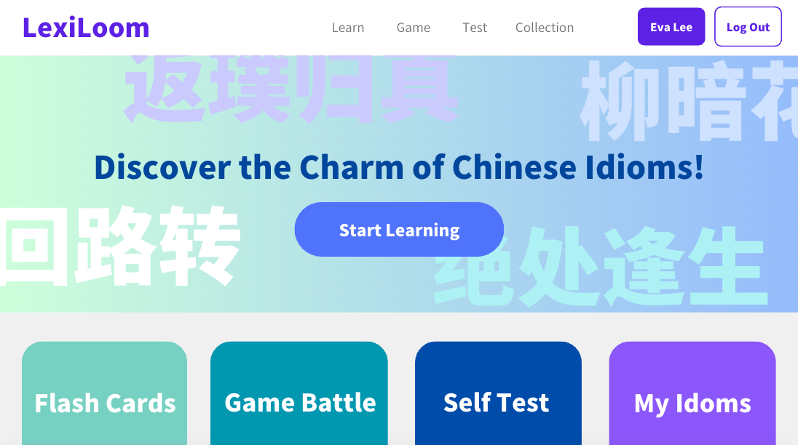
Background
Our project is an interactive Chinese idiom learning platform designed to make learning idioms engaging and effective. Users can explore idioms through pinyin, meanings, and usage examples. Real-time word battles and self-testing features further reinforce learning through competition and practice.
Notes:
This is the home page we create on the online design platform canva. Next, I will walk you through the functions of our system using the mock-ups we designed.

Slide 3
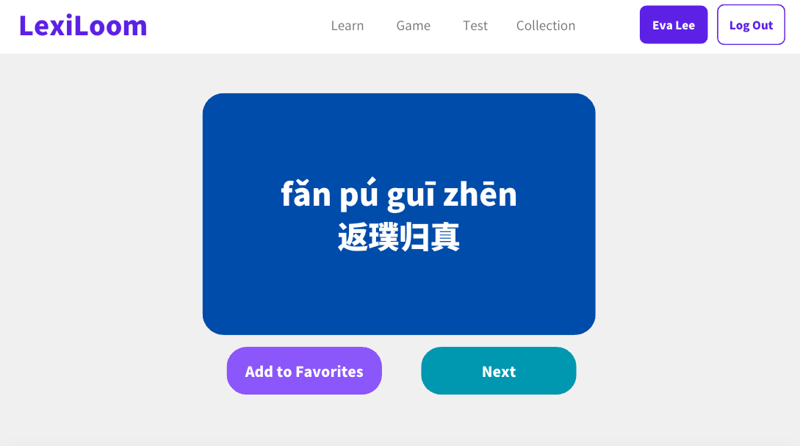
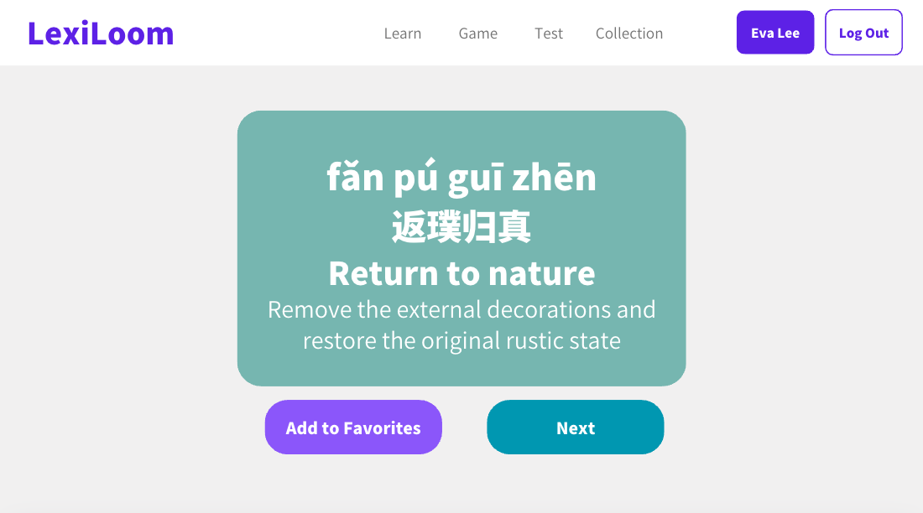
Learning Module
Flash Card: Display a Chinese idiom along with its pinyin, translation, and explanation.

Slide 4
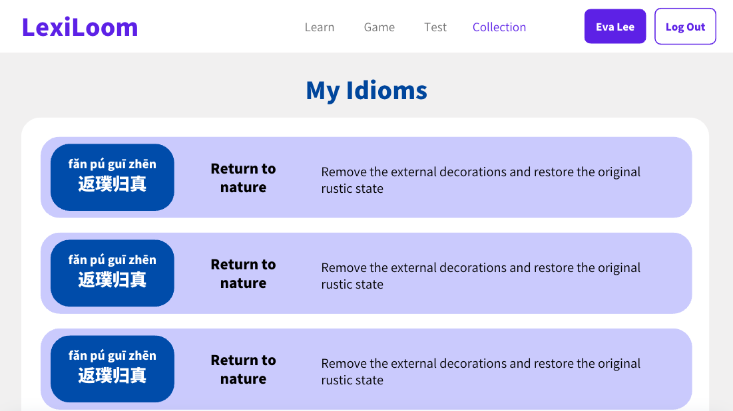
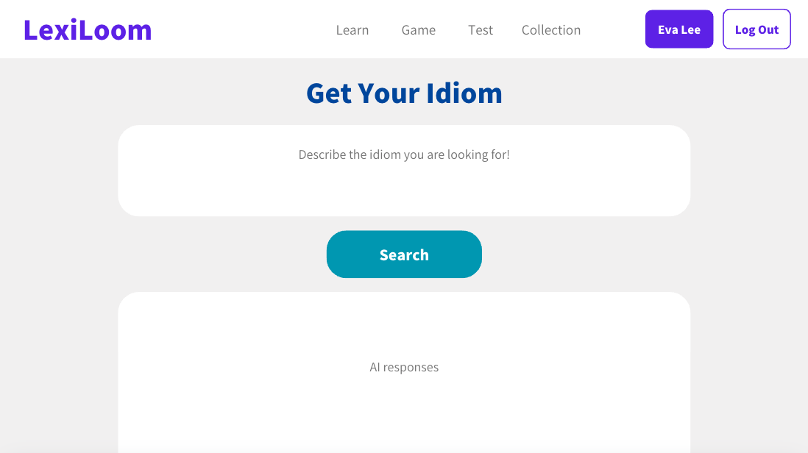
Learning Module
Idiom Collection: Display a comprehensive list of collected idioms of the user.
Idiom Search: Search idioms based on English descriptions.

Slide 5
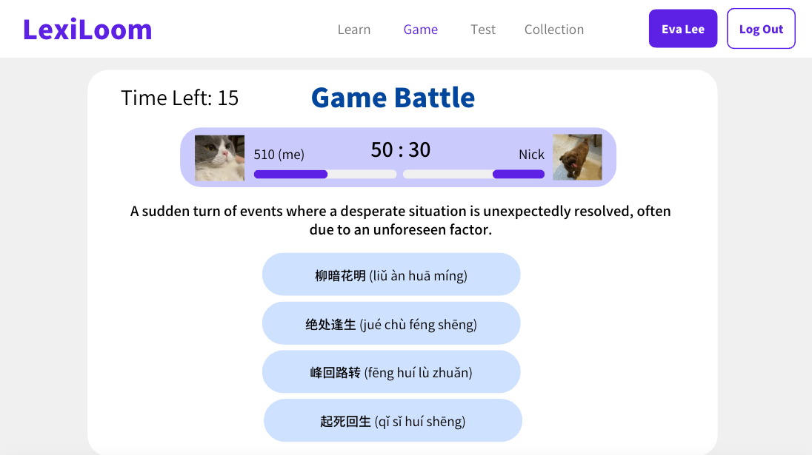
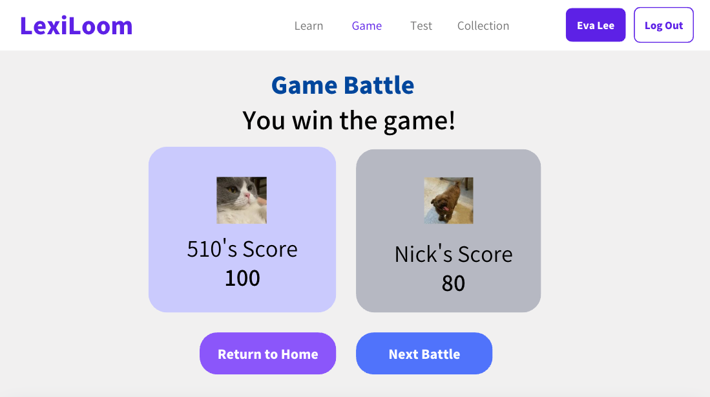
Game Module
Real-time Battle: Compete with a random player in a timed challenge. The two players will be given 10 questions and 20 seconds to answer each question.
Notes:
All questions are single choice. There are two types of questions. One is to choose the closest idiom according to the English description of the idiom, and the other is to choose the closest English interpretation according to the idiom. During the game, a player can see his own and the opponent's progress and scores. The player with the higher score wins.

Slide 6
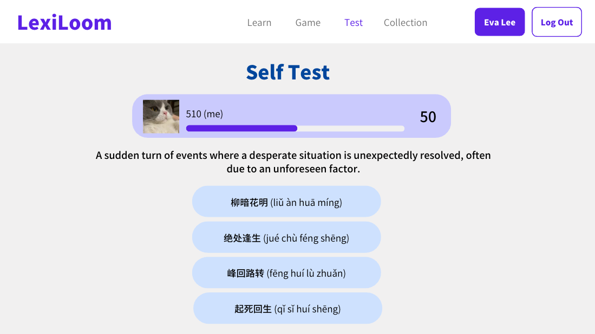
Game Module
Self-testing: Randomized questions for personal practice. The type of problem is the same as described earlier.

Slide 7
Goals for Sprint 1
Front End:
Design and implement the static pages for the home, Learning Module, and Game Module
Responsible by ycheng5 and yulingh
Back End:
Database design and data model representation
Implement models.py
Responsible by qianhuil and xinyiya3

Slide 8
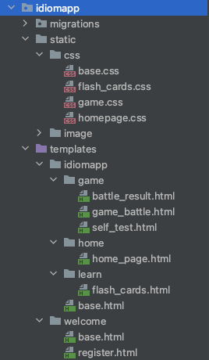
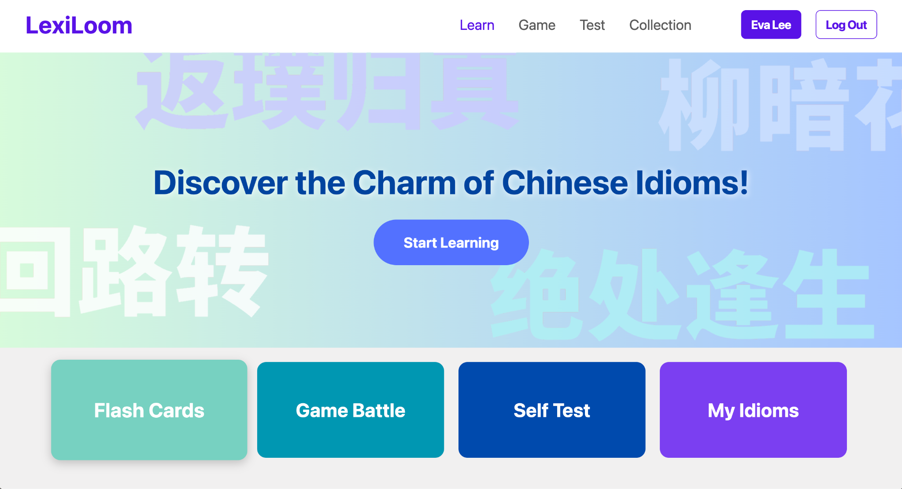
Sprint 1 Achievements - Front End
Home Page
File Structure

Slide 9
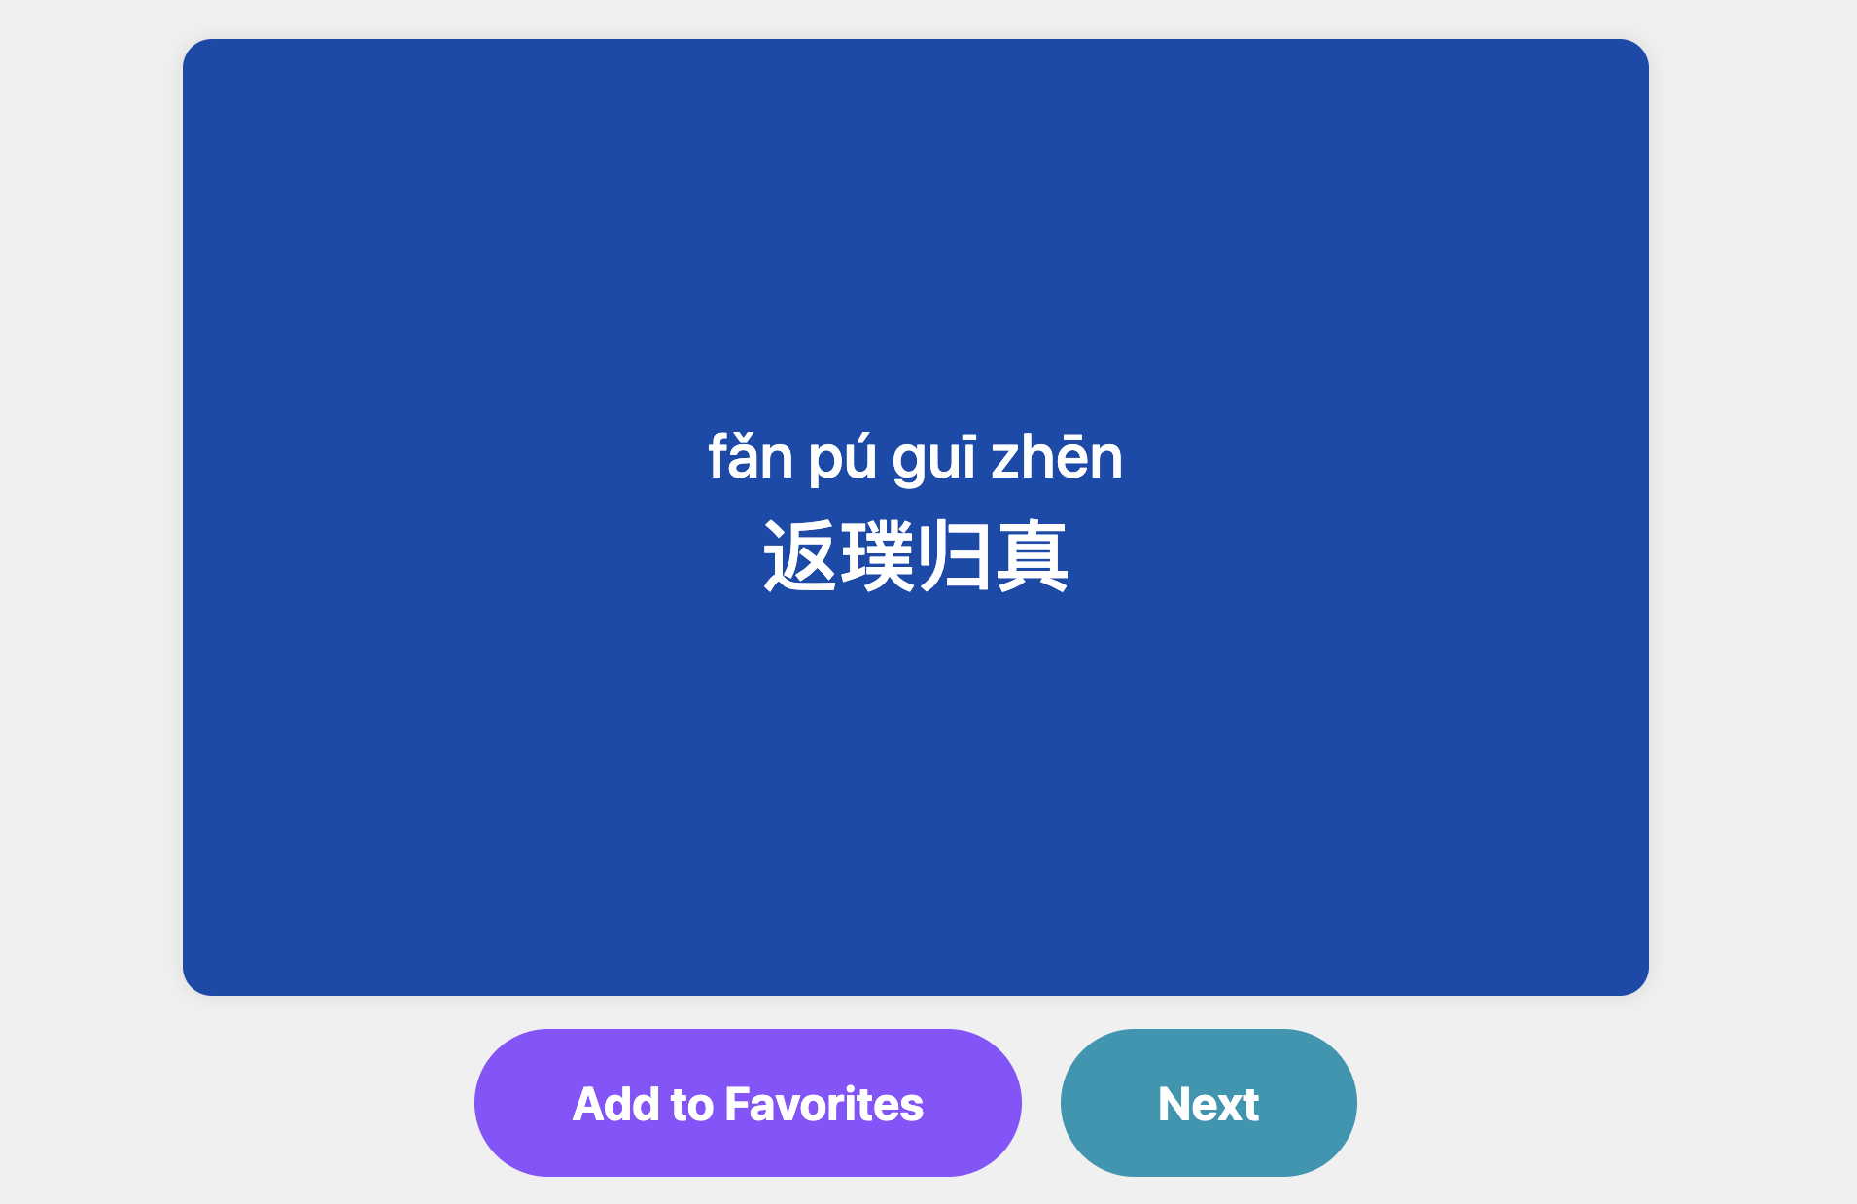
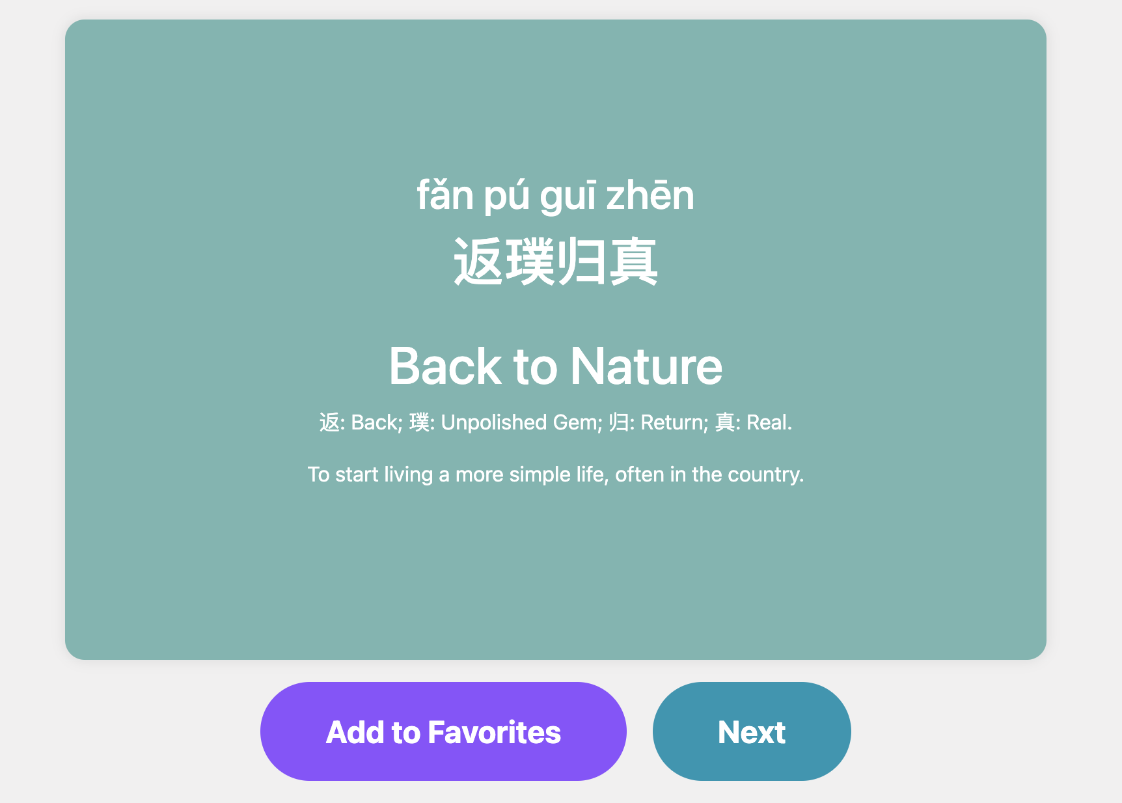
Sprint 1 Achievements - Front End
Flash Card
Notes:
At first, users will only see idioms and pinyin. When you move the mouse over the card, the card will flip over, showing its English translation and explanation.

Slide 10
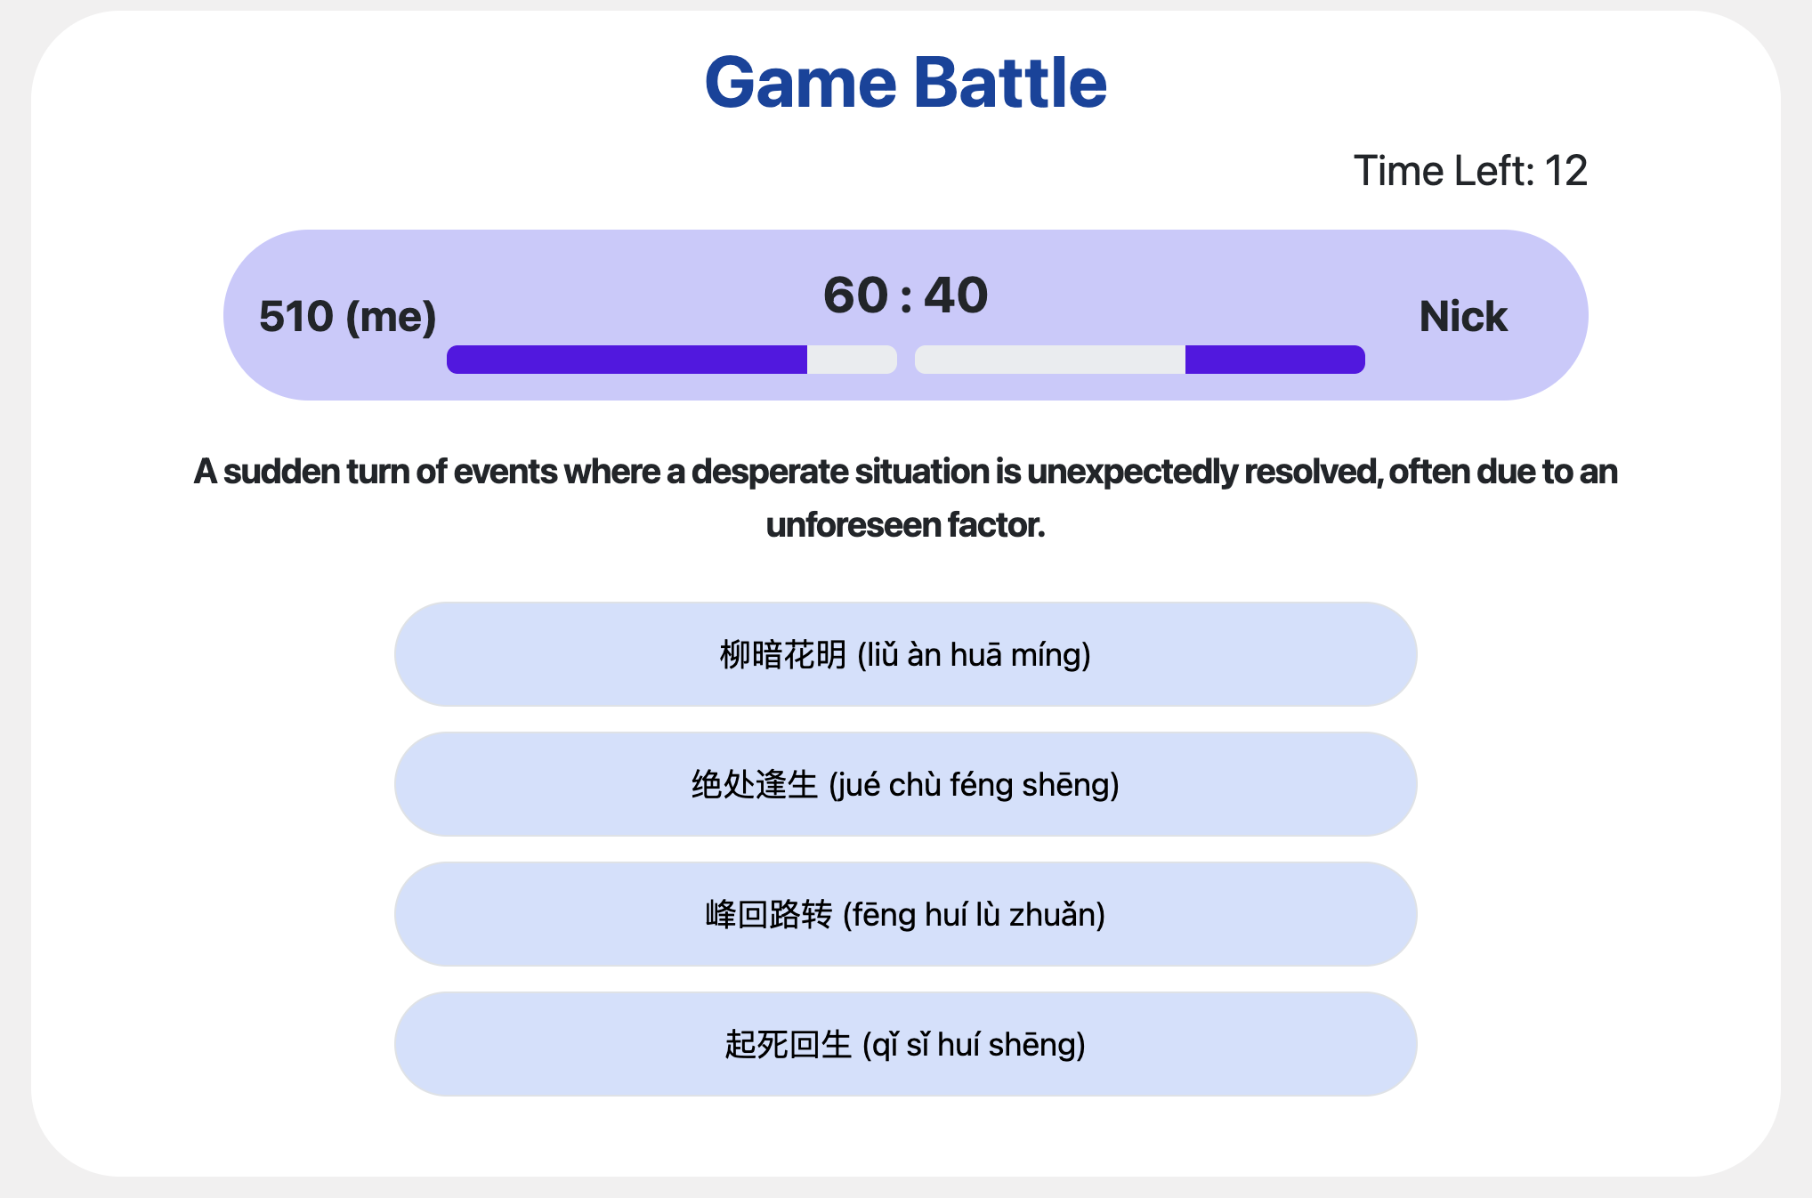
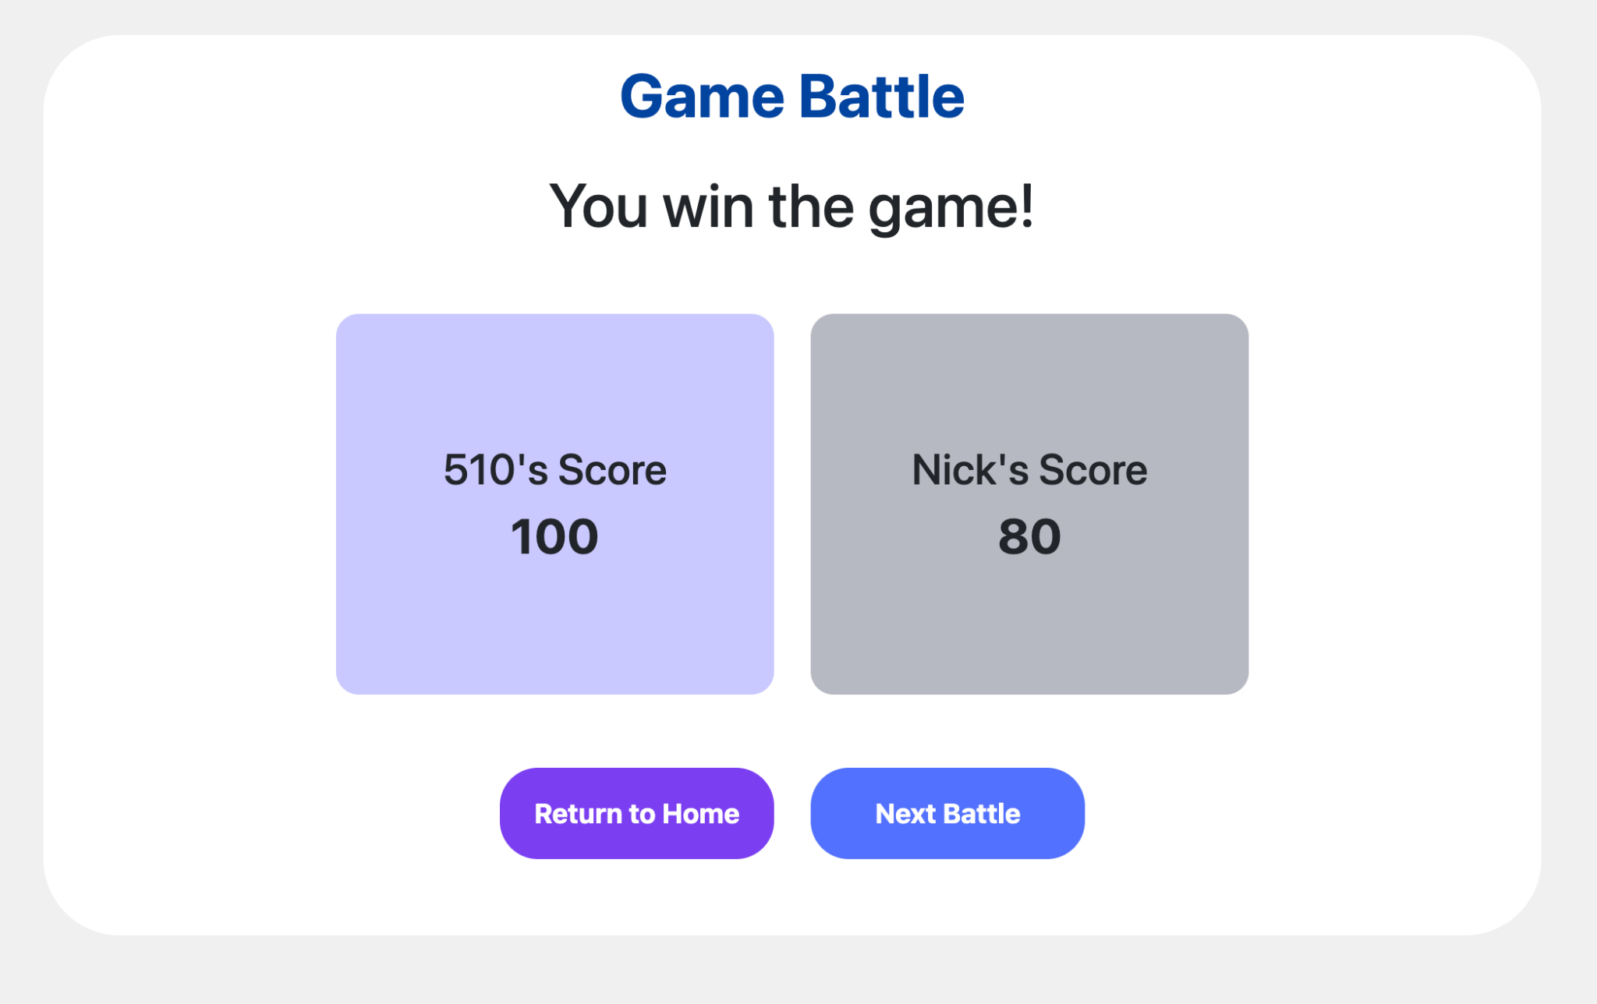
Sprint 1 Achievements - Front End
Game Battle

Slide 11
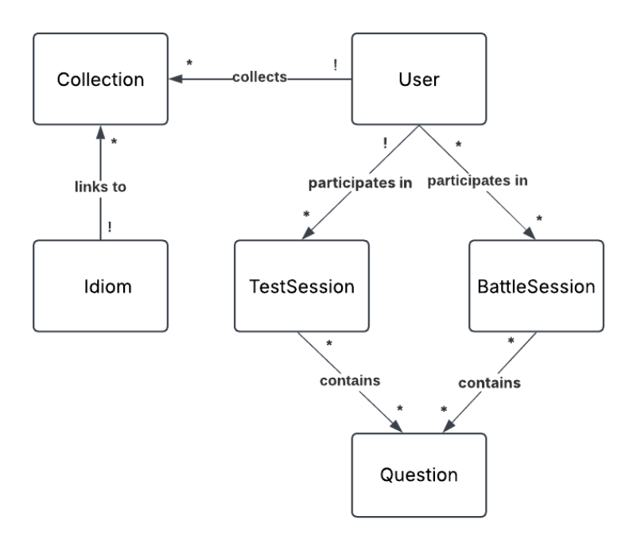
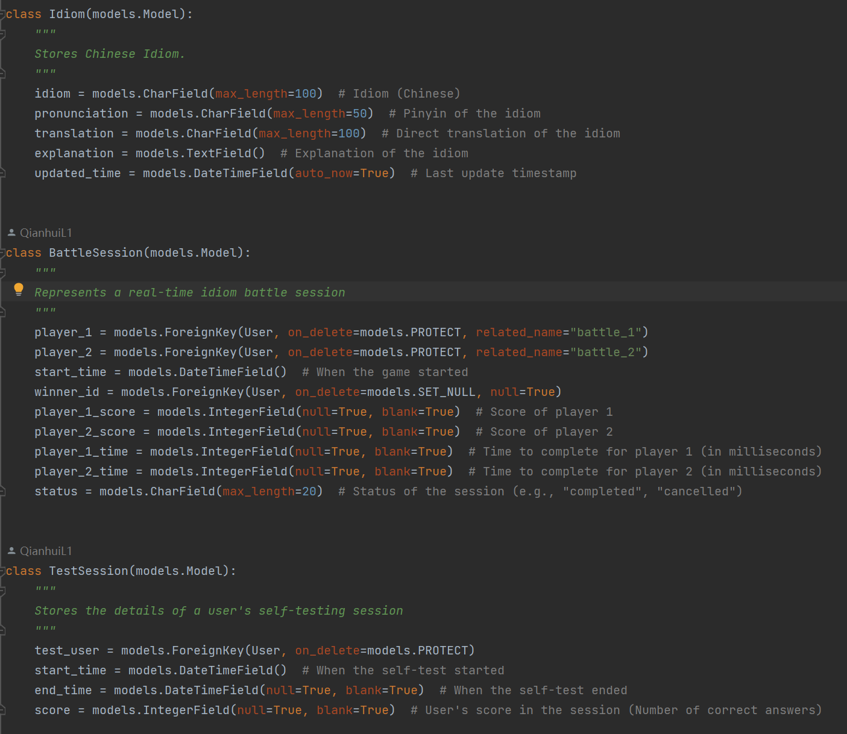
Sprint 1 Achievements - Back End
Data Model
models.py
Notes:
The backend team has discussed and designed the data model for the application based on the system's functionality and has written the code in model.py.

Slide 12
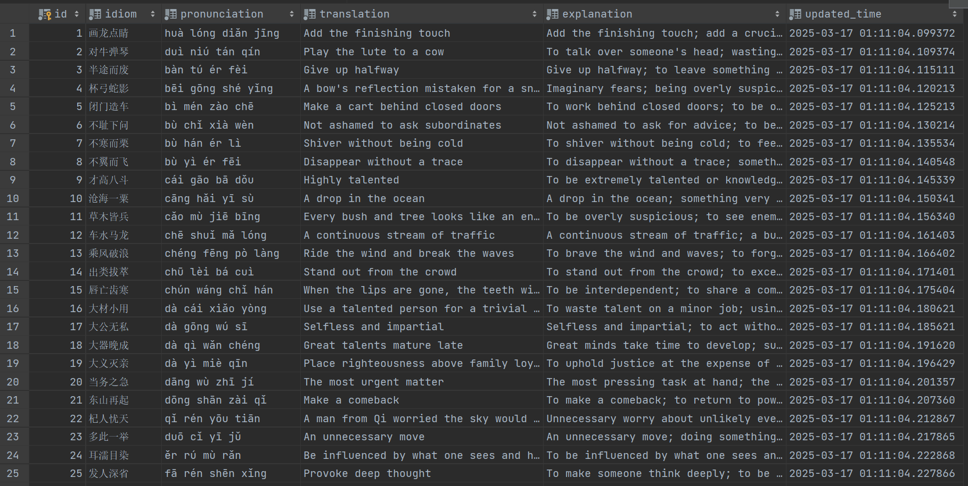
Sprint 1 Achievements - Back End
Idiom Data Collection
Notes:
Additionally, we have gathered a collection of idiom data to store in the database for the learning functionality.

Slide 13
Goals for the Next Sprint
Product owner: Yi Cheng (ycheng5)
Sprint backlog:
Login and register
Front-end and back-end interaction for Flash card
Front-end and back-end interaction for Collection
Front-end and back-end interaction for Self test
Notes:
That’s all for today’s presentation. Thanks for listening! If you have any questions, feel free to ask us!

